Slide 1
Team 6
Web Analytics on Pandemic

Slide 2

Business Problem
This project aims to explain how web analytics can be really helpful in making vital decisions during pandemic situation.
- By comparing the medicine sales contributed by top medicine manufacturers with spread of covid cases in India by all aspects such Day wise, State wise and District wise.
- By assessing the quality of Self-test and PPE kits available in e-commerce websites.
Why ?
Our prime aim is to help the government to take decisions and handle pandemic situations like covid in a better way !

Slide 3

Data Sets
Data Source:
Covid Data – GitHub and Kaggle
PPE and Self-test kits – Data Scraping from e-commerce websites (Amazon)
Medicine Sales - Money Control and Statista (Websites)
Approach
Covid State wise Dataset
Covid Day wise Dataset
Covid District wise Dataset (Delta and Normal variants)
Pharma Sales Dataset
Self-test kits and PPE
Understanding the Problem statement
Gathering relevant data
Data preparation and EDA
Feature Engineering and Feature Extraction
Model Deployment and evaluation
Inference

Slide 4
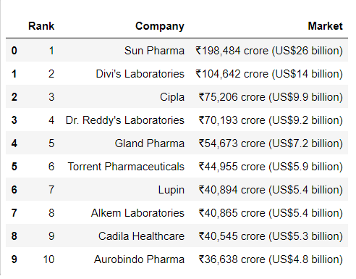
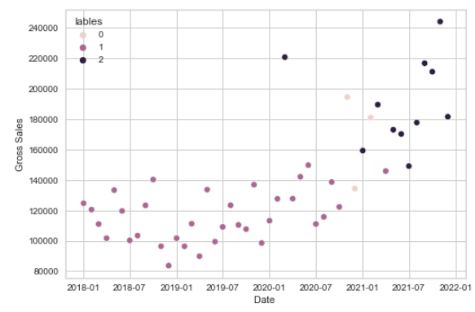
Pharma sales Dataset
Collective medicine sales for the year 2018 – 2021
Month wise sales and purchase
Pretty clean dataset – Data cleaning not required
Used for comparing with covid data
Understanding the traits of sales and purchase
Used Clustering to understand the patterns
Cluster 1 – Sales is uniform
Cluster 0 – Started showing spike in sales
Cluster 2 – Sales increasing rapidly
Model used – K Means Clustering

Slide 5
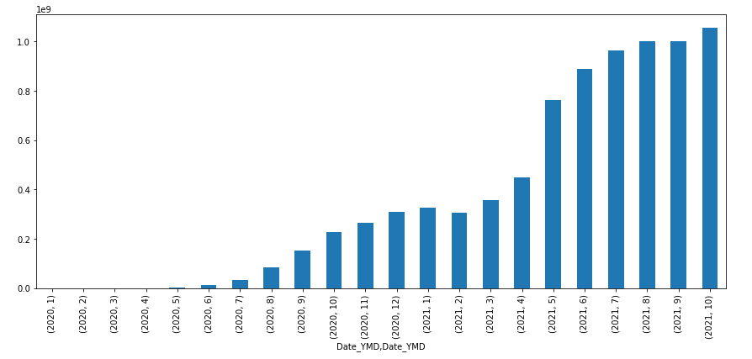
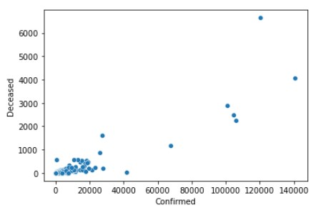
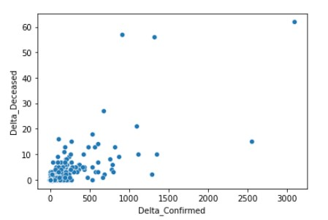
Day wise Dataset
Covid started – May 2020
Medicine Sales spike - July 2020
Is Delta variant deadly ?
Comparing Deceased vs confirmed with
Delta Deceased vs Delta confirmed

Slide 6
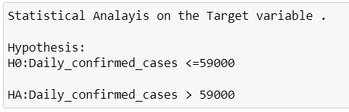
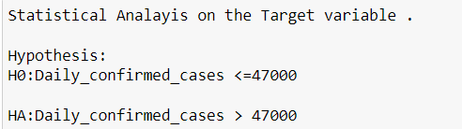

Simple Statistical Analysis
Confidence Level = 98%
alpha = 0.02
Confidence Level = 98%
alpha = 0.02
P value :
P value :
P value < alpha → Reject Null hypothesis
P value > alpha → Failed to Reject Null hypothesis
Average Daily confirmed cases ranges between 47000 to 59000 (approx.)
Can also be used to check if the state can handle the number of cases or not.

Slide 7
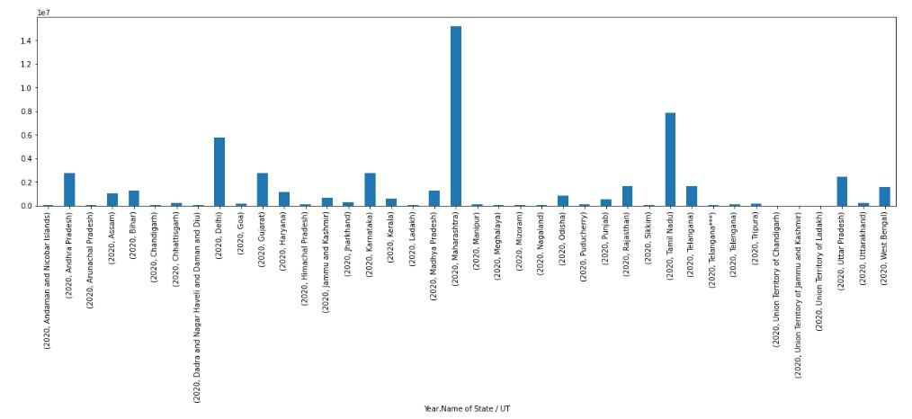
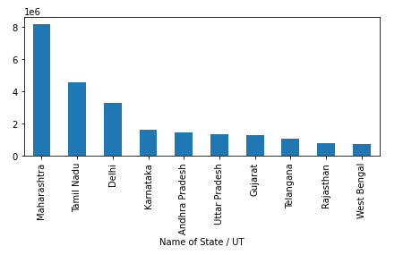
State wise Dataset
[Maharashtra > Tamilnadu > Andhra Pradesh > Karnataka > Delhi]
Most affected states in India by covid
Top 10 States which had more covid cases
By knowing this,
Government can concentrate more on the state which has higher covid cases
Implement extra curfew hours
Plan on more police force (Workforce distribution) to bring order
States can help in maintain supply of medicines to high demand states.
Model used - Linear Regression (OLS)

Slide 8
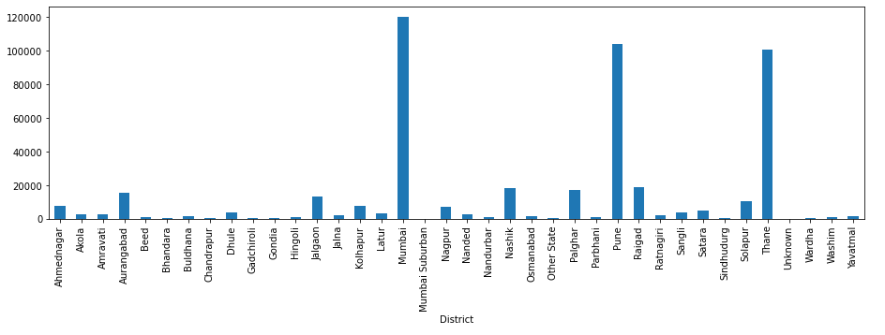
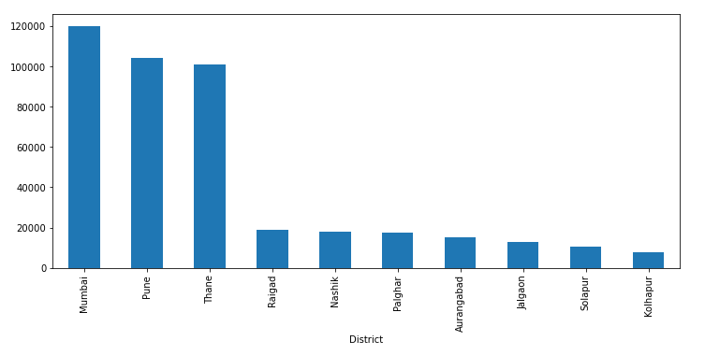
District wise Dataset
Let’s break down States into Districts
Top Districts of Maharashtra
[Mumbai, Pune, Thane, Raigad, Nashik]
Most affected Districts in India by covid
Top 10 Districts which had more covid cases
By knowing this,
State government can take required actions on red zone areas
Close borders for common commuting except for important
Concentrate more on most affected Districts
Plan on medical facilities accordingly
Model used - Linear Regression (OLS)

Slide 9


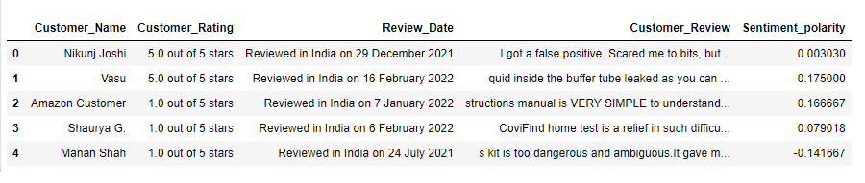
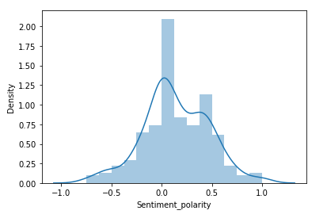
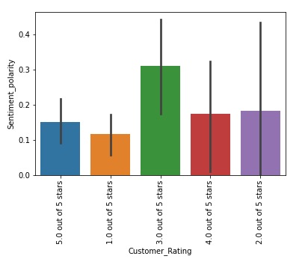
Sentiment Analysis
Self-test Kit
Sample data :
Dataset
Common people’s choice
False Negative – Highly dangerous
Most rating - 3.0/5.0
Lowest rating – 1.0/5.0
Ratio of no. of highest rating to no. of lowest rating should be high
Overall product quality is not good considering the covid scenario

Slide 10






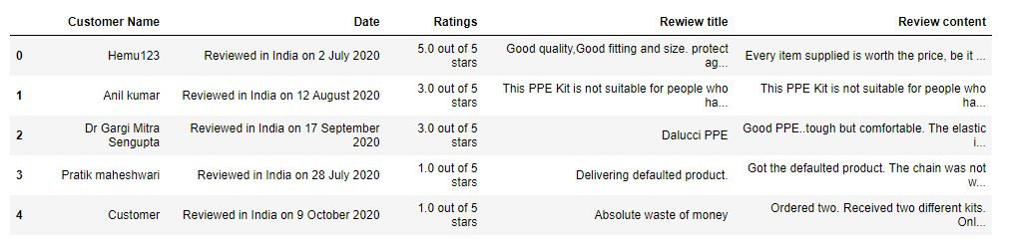
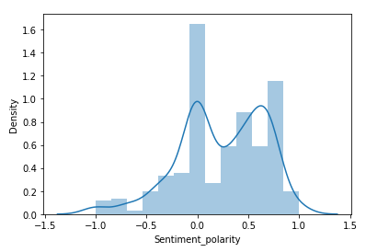
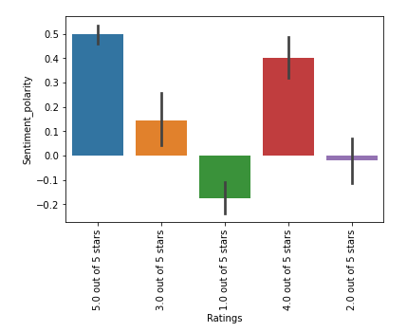
PPE Kits
Sample data :
Also common people’s choice (Daily wage labourers and frontline helpers)
Faulty products can be easily found and avoided
Most rating - 5.0/5.0
Lowest rating – 2.0/5.0
Ratio of no. of highest rating to no. of lowest rating should be high
Overall product quality is satisfactory

Slide 11
Conclusion
Traits of Pharma Sales in India
Effect covid on Medicine sales
Average cases in India
State wise analysis on covid with helpful insights
District wise analysis on covid with Delta variant analysis
Sentiment Analysis on PPE and self test kits
Ultimately, collective information to the government for the betterment of people
Ideology suggestion – by our team

Slide 12
Thank You

